Slide 1
Swin Transformer: Hierarchical Vision Transformer using Shifted Windows
Ze Liu†* Yutong Lin†* Yue Cao* Han Hu*‡ Yixuan Wei†
Zheng Zhang Stephen Lin Baining Guo
Microsoft Research Asia

Slide 2
摘要
This paper presents a new vision Transformer, called Swin Transformer, that capably serves as a general-purpose backbone for computer vision. Challenges in adapting Transformer from language to vision arise from differences between the two domains, such as large variations in the scale of visual entities and the high resolution of pixels in images compared to words in text. To address these differences, we propose a hierarchical Transformer whose representation is computed with Shifted windows. The shifted windowing scheme brings greater efficiency by limiting self-attention computation to non-overlapping local windows while also allowing for cross-window connection. This hierarchical architecture has the flexibility to model at various scales and has linear computational complexity with respect to image size. These qualities of Swin Transformer make it compatible with a broad range of vision tasks, including image classification (87.3 top-1 accuracy on ImageNet-1K) and dense prediction tasks such as object detection (58.7 box AP and 51.1 mask AP on COCO testdev) and semantic segmentation (53.5 mIoU on ADE20K val). Its performance surpasses the previous state-of-theart by a large margin of +2.7 box AP and +2.6 mask AP on COCO, and +3.2 mIoU on ADE20K, demonstrating the potential of Transformer-based models as vision backbones. The hierarchical design and the shifted window approach also prove beneficial for all-MLP architectures.
提出了新的Swin Transformer模型应用于cv领域
解决了从nlp到cv领域的巨大的差距，例如像素和分辨率等
采用方法是移动窗口，使临近区域关系更加密切，使用更加灵活，计算效率上升，层级式窗口设计达到全局建模的目的
计算复杂度随窗口大小线性增长

Slide 3
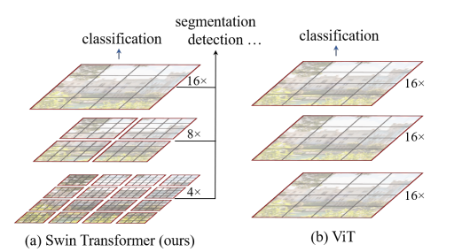
贡献总结 感受野优势
ViT单一尺寸 （16倍下采样）作用于整个图片，对于密集型效果欠佳并且复杂度成平方增加
SwimTransformer在小窗口进行，计算复杂度与窗口成线性关系
为实现卷积神经网络的类似功能，小窗口合成大窗口，在大窗口里可以看到4个小窗口的内容
这是骨干型的网络，能做密集型和图像分割的任务

Slide 4
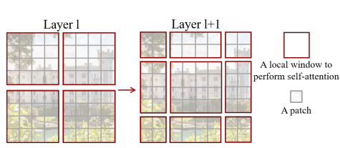
贡献总结 注意力优势
按照大窗口里面套小窗口的方式分割图片，之后向右下角移动两个小窗口（目的：带入窗口之间的注意力，增强窗口之间的联系，加强全局建模的能力）
推动nlp和cv紧密结合

Slide 5
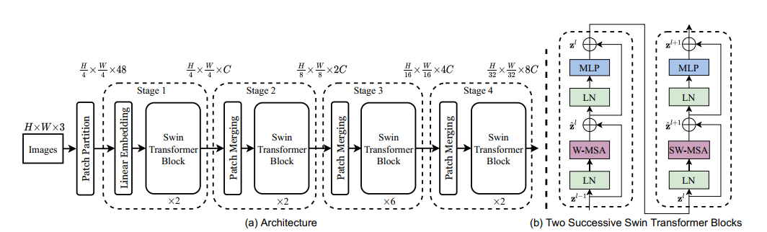
结构图
An overview of the Swin Transformer architecture is presented in Figure 3, which illustrates the tiny version (SwinT). It first splits an input RGB image into non-overlapping patches by a patch splitting module, like ViT. Each patch is treated as a “token” and its feature is set as a concatenation of the raw pixel RGB values. In our implementation, we use a patch size of 4 × 4 and thus the feature dimension of each patch is 4 × 4 × 3 = 48. A linear embedding layer is applied on this raw-valued feature to project it to an arbitrary dimension (denoted as C).Several Transformer blocks with modified self-attention computation (Swin Transformer blocks) are applied on these patch tokens. The Transformer blocks maintain the number of tokens (H/4 × W/4 ), and together with the linear embedding are referred to as “Stage 1”. To produce a hierarchical representation, the number of tokens is reduced by patch merging layers as the network gets deeper. The first patch merging layer concatenates the features of each group of 2 × 2 neighboring patches, and applies a linear layer on the 4C-dimensional concatenated features. This reduces the number of tokens by a multiple of 2×2 = 4 (2× downsampling of resolution), and the output dimension is set to 2C. Swin Transformer blocks are applied afterwards for feature transformation, with the resolution kept at H8 × W8 . This first block of patch merging and feature transformation is denoted as “Stage 2”. The procedure is repeated twice, as “Stage 3” and “Stage 4”, with output resolutions of 16 H × W16 and 32 H × W32 , respectively. These stages jointly produce a hierarchical representation,with the same feature map resolutions as those of typical convolutional networks, e.g., VGG [52] and ResNet [30]. As a result, the proposed architecture can conveniently replace the backbone networks in existing methods for various vision tasks
Notes:
计算量主要来自编码器，只看没被遮住的四分之一就够了

Slide 6
Swim Transformer Block
1 | 2 | 1 | 2
3 | 4 | 3 | 4
1 | 2 | 1 | 2
3 | 4 | 3 | 4
H
Swin Transformer is built by replacing the standard multi-head self attention (MSA) module in a Transformer block by a module based on shifted windows (described in Section 3.2), with other layers kept the same. As illustrated in Figure 3(b), a Swin Transformer block consists of a shifted window based MSA module, followed by a 2-layer MLP with GELU nonlinearity in between. A LayerNorm (LN) layer is applied before each MSA module and each MLP, and a residual connection is applied after each module
W
1 | 1
1 | 1
2 | 2
2 | 2
3 | 3
3 | 3
4 | 4
4 | 4
H/2
W/2
4 | 4
4 | 4
3 | 3
3 | 3
2 | 2
2 | 2
H/2*W/2*4c
1 | 1
1 | 1
H/2*W/2*2c

Slide 7

自注意力窗口计算量 Self-attention in non-overlapped windows
For efficient modeling, we propose to compute self-attention within local windows. The windows are arranged to evenly partition the image in a non-overlapping manner. Supposing each window contains M × M patches, the computational complexity of a global MSA module and a window based one on an image of h × w patches are3:
where the former is quadratic to patch number hw, and the latter is linear when M is fixed (set to 7 by default). Global self-attention computation is generally unaffordable for a large hw, while the window based self-attention is scalable.
公式1：多头自注意力复杂度
公式2：基于窗口的复杂度
CxC
投影
Q
a
K
hw*hw
hwc
hwc
hwc
V
hwc
M/h*M/w
X
4M^2*C^2+2M^4*C

Slide 8
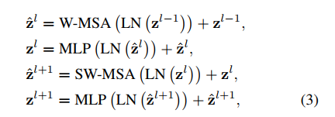
移动窗口计算量 Shifted window partitioning in successive blocks
The window-based self-attention module lacks connections across windows, which limits its modeling power. To introduce cross-window connections while maintaining the efficient computation of non-overlapping windows, we propose a shifted window partitioning approach which alternates between two partitioning configurations in consecutive Swin Transformer blocks. As illustrated in Figure 2, the first module uses a regular window partitioning strategy which starts from the top-left pixel, and the 8 × 8 feature map is evenly partitioned into 2 × 2 windows of size 4 × 4 (M = 4). Then, the next module adopts a windowing configuration that is shifted from that of the preceding layer, by displacing the windows by (bM2 c; bM2 c) pixels from the regularly partitioned windows. With the shifted window partitioning approach, consecutive Swin Transformer blocks are computed as
先做基于窗口的多头自注意力，在做基于移动窗口的多头自注意力

Slide 9
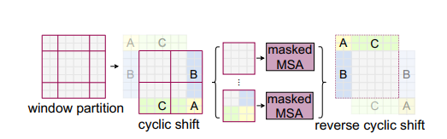
移动窗口
通过先把AC向下位移再把BA向右位移，最终拼凑成一个与原图像大小一致的4个大窗口
不占唯一的块之间直接算自注意力，有位移的块进行掩码再算自注意力
最终还原（防止循环操作造成的语义丢失）

Slide 10
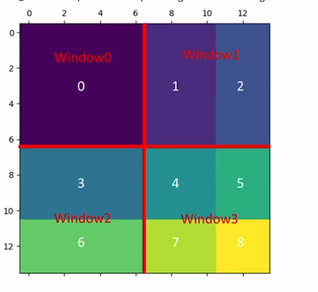
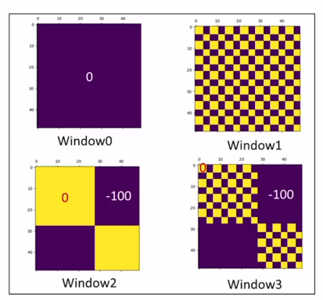
移动窗口掩码

Slide 11
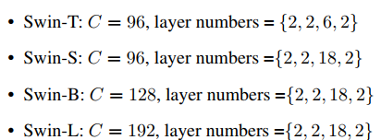
模型扩展
We build our base model, called Swin-B, to have of model size and computation complexity similar to ViTB/DeiT-B. We also introduce Swin-T, Swin-S and Swin-L, which are versions of about 0:25×, 0:5× and 2× the model size and computational complexity, respectively. Note that the complexity of Swin-T and Swin-S are similar to those of ResNet-50 (DeiT-S) and ResNet-101, respectively. The window size is set to M = 7 by default. The query dimension of each head is d = 32, and the expansion layer of each MLP is α = 4, for all experiments. The architecture hyper-parameters of these model variants are:
Notes:
向量维度c transformer bilock数量

Slide 12
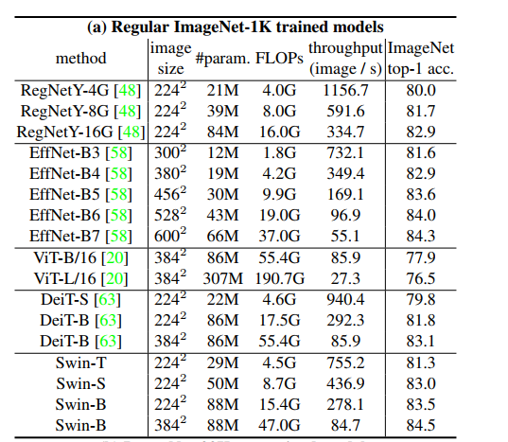
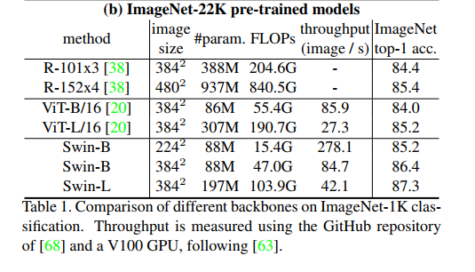
实验 不同数据集

Slide 13
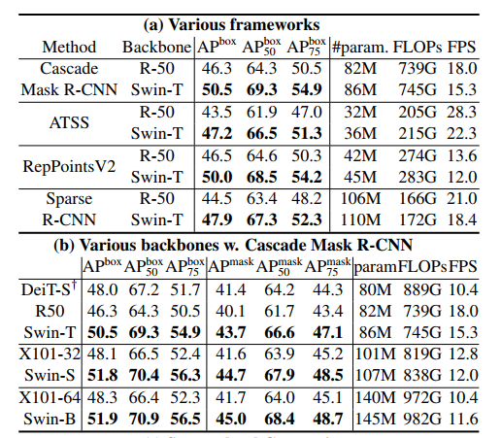
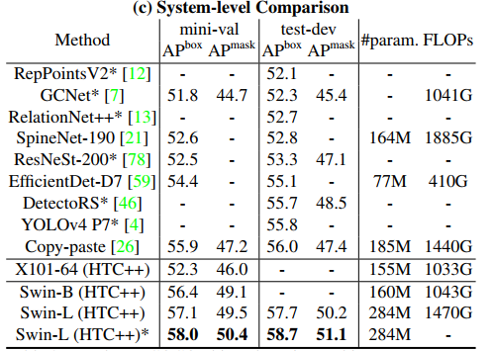
实验 不同框架，无限制

Slide 14
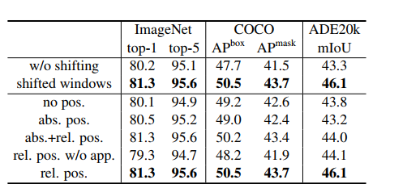
实验 不同任务目标
因为加入了移动窗口，加强了窗口支架的联系，所以在目标检测和语义分割上提升效果明显

